Slide 1

ALY 6080 – Analytics System Technology Capstone Project : India Crime Data Analysis
Submitted by:
Saurabh Zulkanthiwar

Slide 2
Agenda
Introduction
Goals and Question
Exploratory Data Analysis
Predictive Modeling
Conclusion

Slide 3
Introduction
Source : Dataworld
State-wise crime data from 2001-2014 is classified according to 30+factors.
The dataset contains information on different categories of crime in India based on which we could build we can forecast models.
Information like State, District, and Year available along with Total IPC Crimes, Rapes, Murders, Kidnapping among major variables.
Consists of 34 columns and 10678 rows

Slide 4
Goals and Questions
Goals:
Clean and Preprocess dataset
Perform EDA
Build predictive models
Research questions:
Which is the most prevalent crime in India?
How is the trend for crimes against women?
Which state and districts account for most cases of rapes?
Build linear and logistic regression modelsto predict crimes

Slide 5
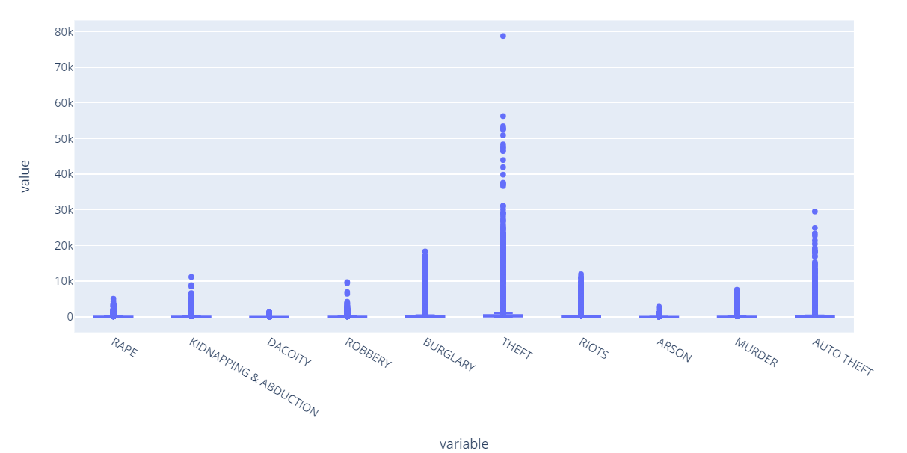
Exploratory Data Analysis
Dispersion of Recorded cases across India.

Slide 6
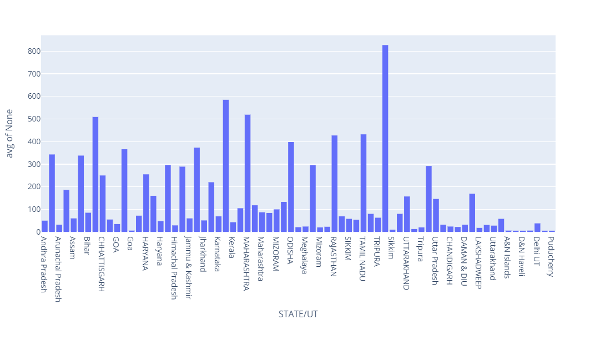
Exploratory Data Analysis
Average cases In India across different state

Slide 7
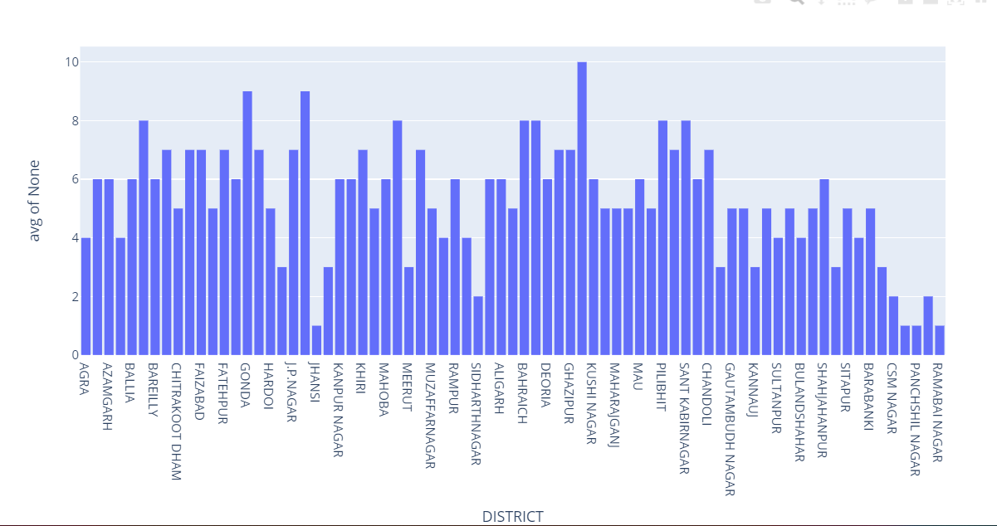
Exploratory Data Analysis
Average cases across different districts in Uttar Pradesh

Slide 8
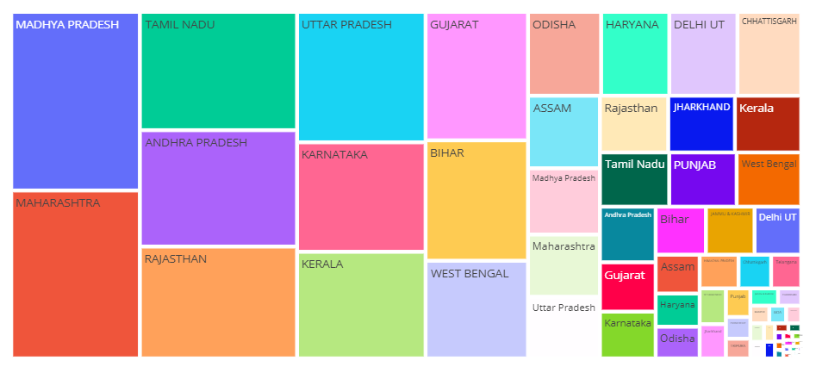
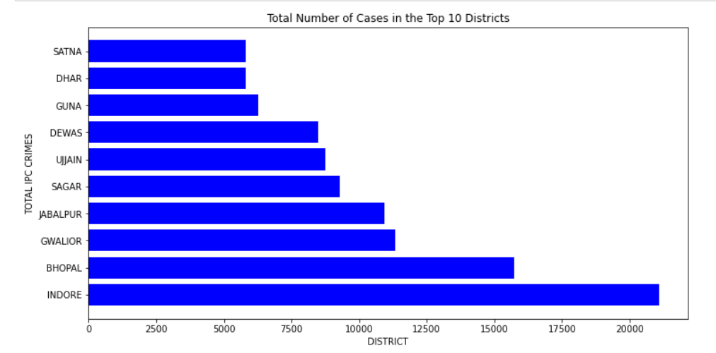
Exploratory Data Analysis
Most cases across different districts in Madhya Pradesh.
Cases Recorded across different district in Madhya Pradesh

Slide 9
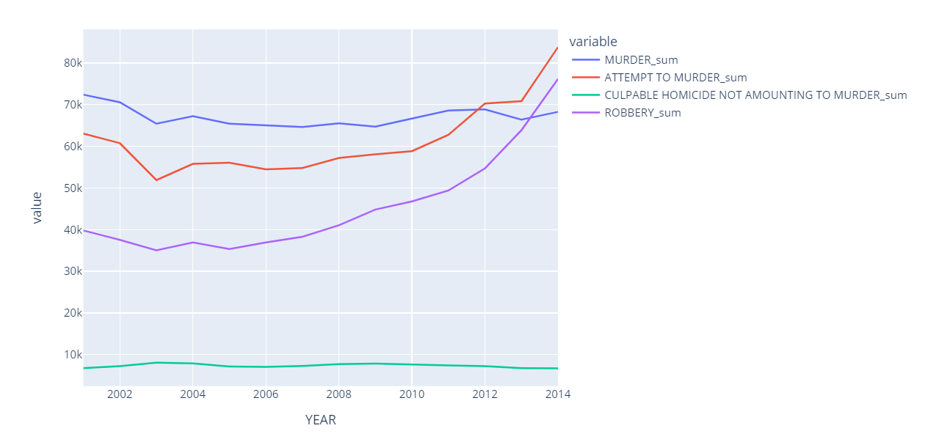
Exploratory Data Analysis
Analyzing trend of most violent crimes.

Slide 10
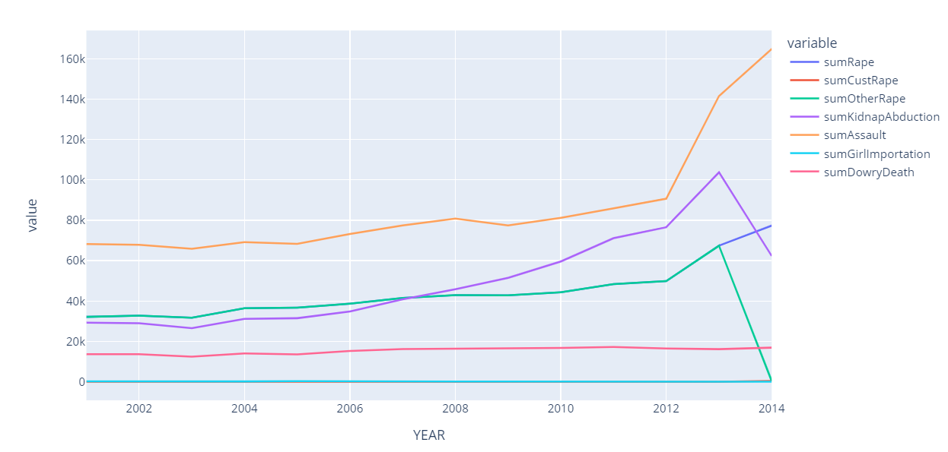
Exploratory Data Analysis
Analyzing trend of crimes committed against women.

Slide 11
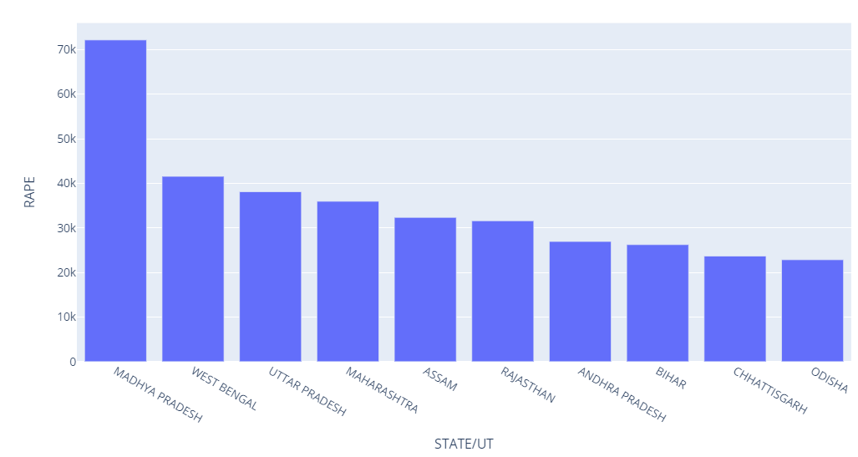
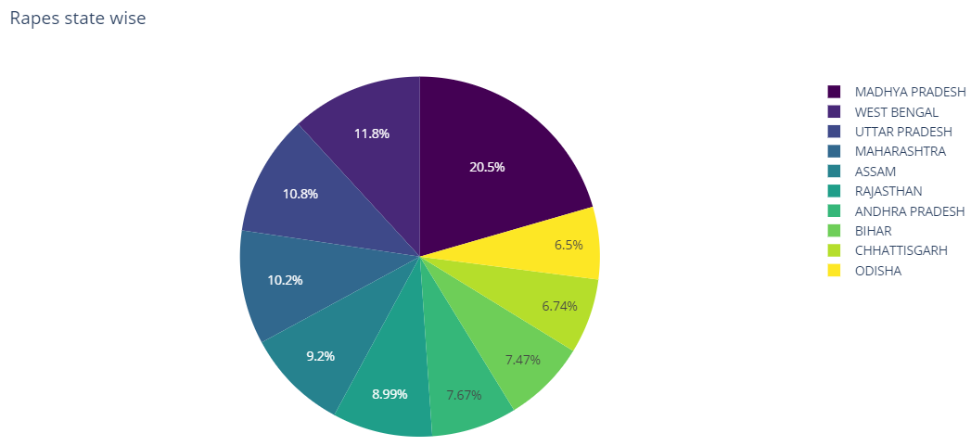
Exploratory Data Analysis
Analyzing crime for Rape against women.

Slide 12
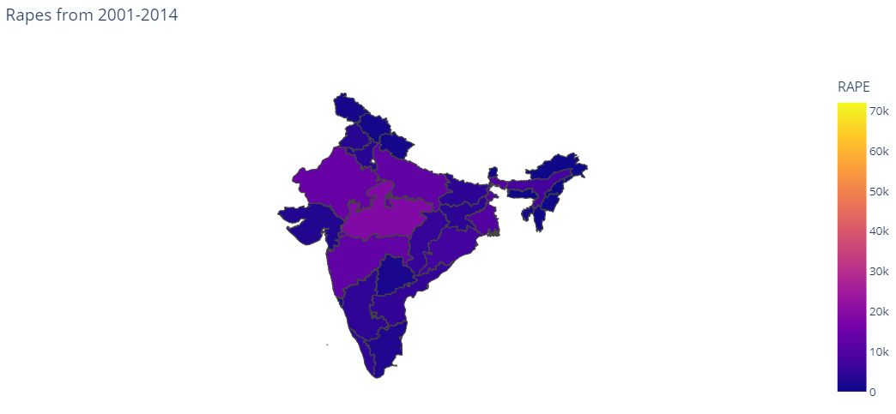
Exploratory Data Analysis
Density of Rape cases across.

Slide 13
Linear Regression Logistic Regression
Predictive Modeling Techniques

Slide 14
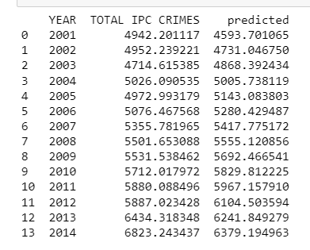
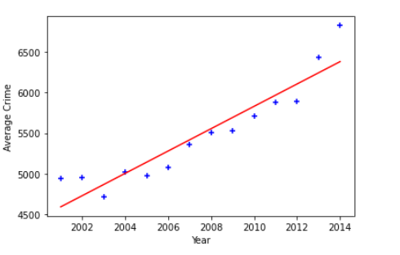

Linear Regression
Dependent Variable X – Total IPC Crime
Independent Variable Y - Year

Slide 15

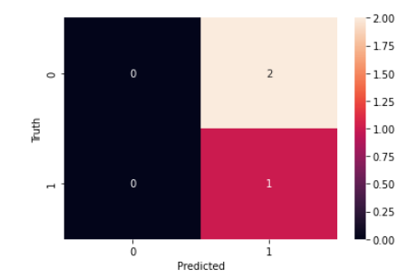
Logistic Regression
Dependent Variable X – Total IPC Crime
Independent Variable Y – Year
Splitting Into Test and Train Data

Slide 16
Conclusion
Theft cases have the most dispersion in the dataset.
UP and MP are the states with most recorded crimes.
Hamirpur in UP has most number of average cases.
Indore in MP has most recorded cases.
Assault is the most committed crime.
Cases of Rape are most common in Madhya Pradesh with nearly 20.5% of total cases.
Best fitted model for forecasting
Y(Crime)= 137.34 X(YEAR) -270235

Slide 17
Thank You

